Slide 1


Computer Architecture Spring 2020
Hamed Farbeh
farbeh@aut.ac.ir
Department of Computer Engineering
Amirkabir University of Technology

Slide 2
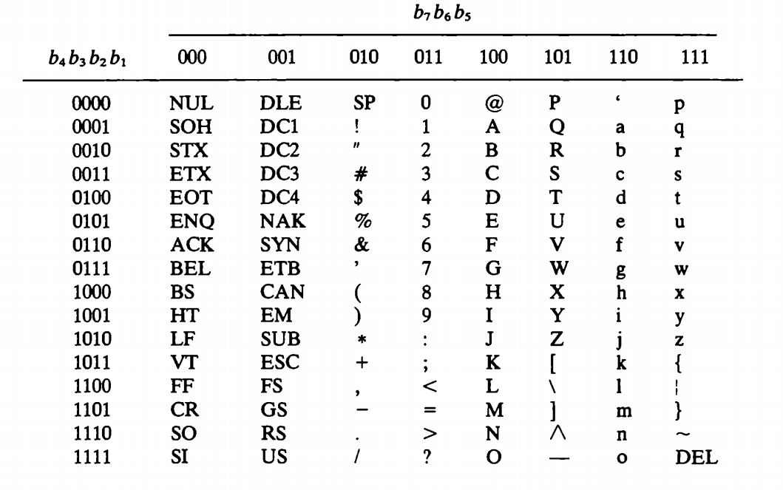
Input-Output Organization
ASCII alphanumeric Characters
Computer Architecture-Spring 2020, AUT, Tehran, Iran

Slide 3
Input-Output Organization
Connection to I/O
Data bus
Address bus
Control signals
Control command
Status command
Data output command
Data input command
Computer Architecture-Spring 2020, AUT, Tehran, Iran

Slide 4
Input-Output Organization
CPU connection: Memory vs I/O
Two separate buses
One common bus and separate control lines
On common bus and One common control lines
Isolated I/O vs memory-mapped I/O
Computer Architecture-Spring 2020, AUT, Tehran, Iran

Slide 5
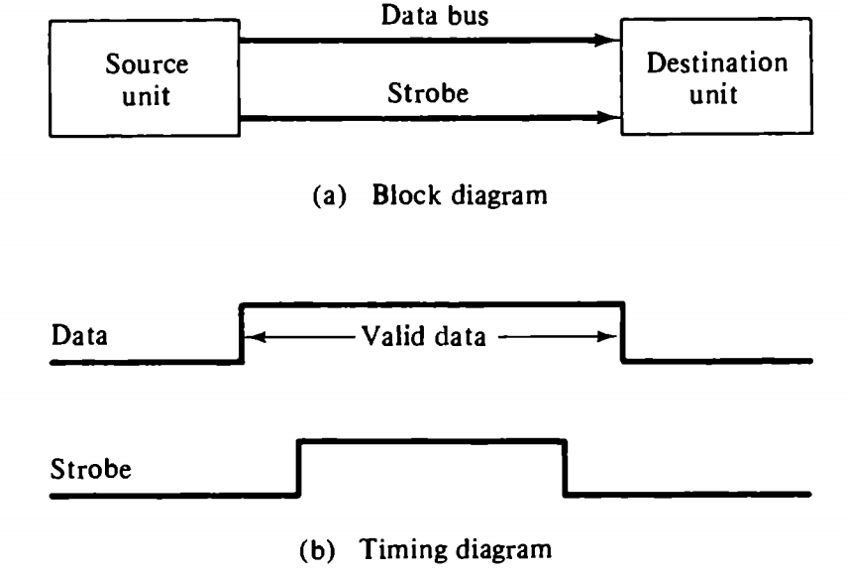
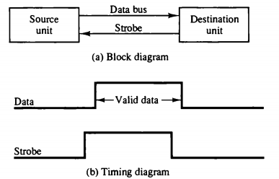
Input-Output Organization
Asynchronous Data Transfer
Strobe control
Source-initiated
Destination-initiated
Computer Architecture-Spring 2020, AUT, Tehran, Iran

Slide 6
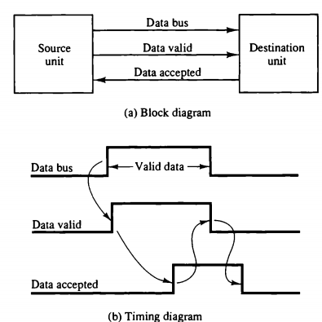
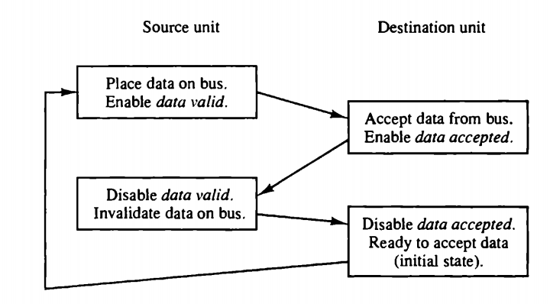
Input-Output Organization
Asynchronous Data Transfer
Handshaking
Source-initiated
Computer Architecture-Spring 2020, AUT, Tehran, Iran

Slide 7
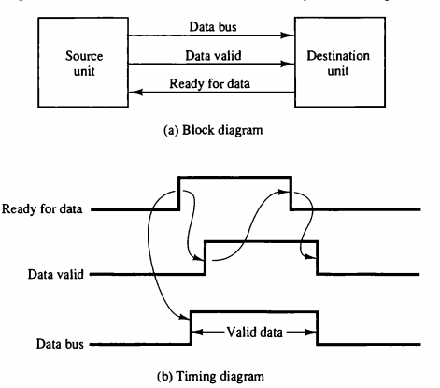
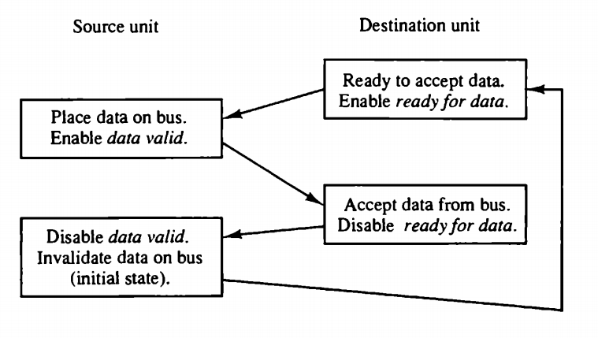
Input-Output Organization
Asynchronous Data Transfer
Handshaking
Destination-initiated
Computer Architecture-Spring 2020, AUT, Tehran, Iran

Slide 8
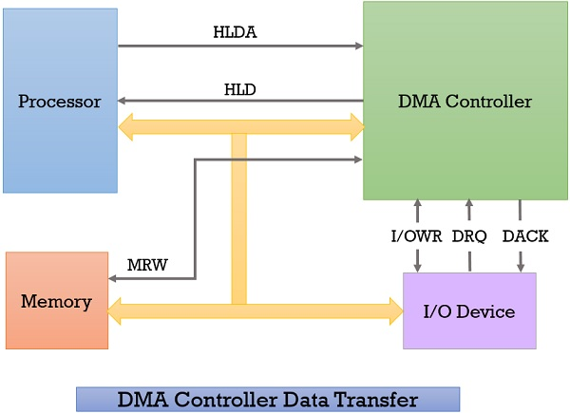
Direct Memory Access (DMA)
A method that allows an input/output (I/O) device to send or receive data directly to or from the main memory
Bypassing the CPU to speed up memory operations
Is managed by a chip known as a DMA controller (DMAC)
Computer Architecture-Spring 2020, AUT, Tehran, Iran

Slide 9
Direct Memory Access (DMA)
DMA controller transfers the data in three modes
Burst Mode: Here, once the DMA controller gains the charge of the system bus, then it releases the system bus only after completion of data transfer. Till then the CPU has to wait for the system buses.
Cycle Stealing Mode: In this mode, the DMA controller forces the CPU to stop its operation and relinquish the control over the bus for a short term to DMA controller. After the transfer of every byte, the DMA controller releases the bus and then again requests for the system bus. In this way, the DMA controller steals the clock cycle for transferring every byte.
Transparent Mode: Here, the DMA controller takes the charge of system bus only if the processor does not require the system bus.
Computer Architecture-Spring 2020, AUT, Tehran, Iran

